Slide 1
Applications Solar Photovoltaic Conversion Solar Photovoltaic, Solar Thermal, Applications Of Solar
SlideMake.com

Slide 2
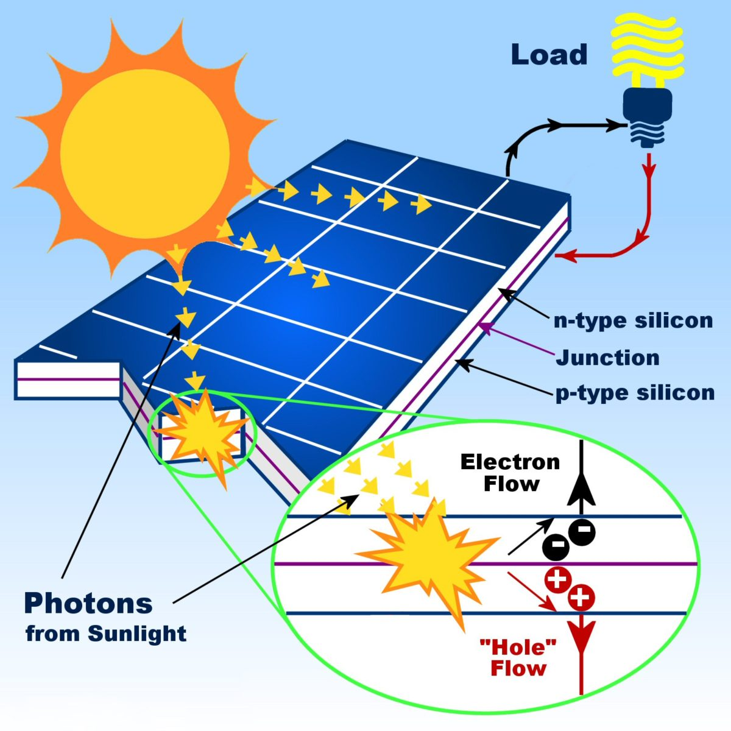
Introduction to Solar Photovoltaic Conversion
Solar photovoltaic conversion refers to the process of converting solar energy into electricity.
This technology uses solar panels to capture sunlight and convert it into usable energy.
Solar photovoltaic systems have numerous applications in various sectors.
Notes:
Image source: https://ruahaenergy.com/solar/solar-overview/

Slide 3
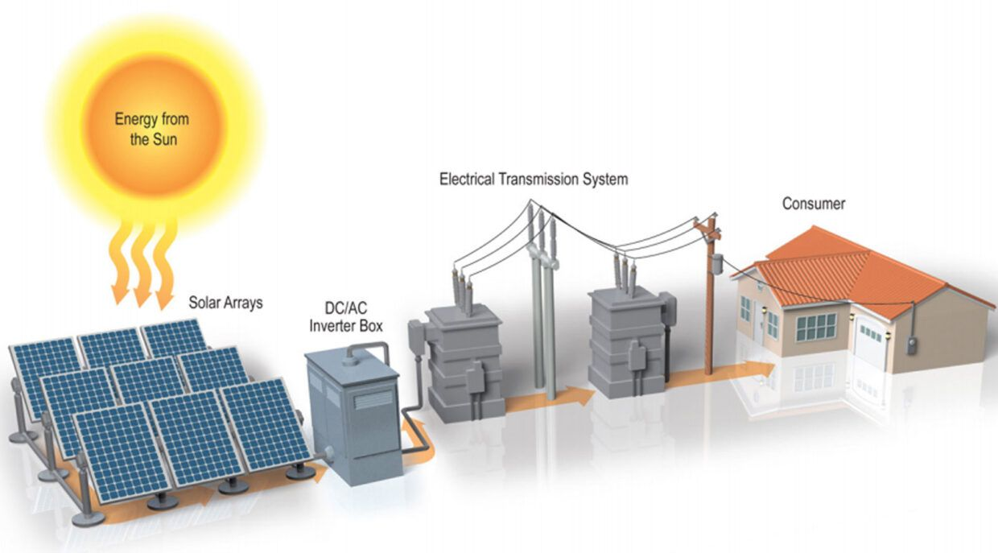
Solar Photovoltaic Power Plants
Solar photovoltaic power plants generate large-scale electricity from sunlight.
These power plants can be grid-connected or off-grid, providing clean and sustainable energy.
Solar photovoltaic power plants are being increasingly deployed worldwide to meet the growing demand for renewable energy.
Notes:
Image source: https://www.arka360.com/ros/solar-farms-grid-connected-pv-plants/

Slide 4
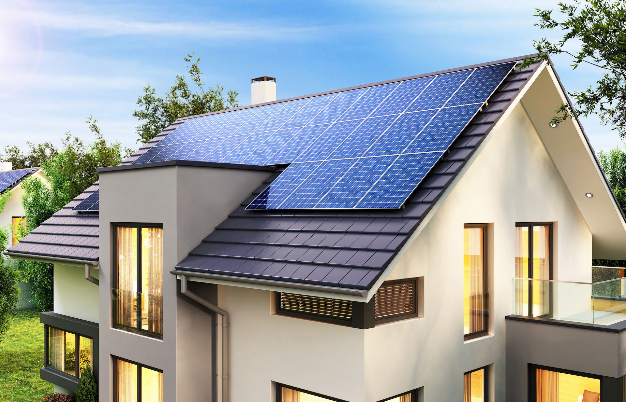
Residential Solar PV Systems
Residential solar photovoltaic systems are installed on rooftops of homes to generate electricity for household use.
These systems help reduce electricity bills and dependence on the grid.
Residential solar PV systems also contribute to reducing carbon emissions and promoting sustainability.
Notes:
Image source: https://www.yorkshireroofing.com/solar/

Slide 5
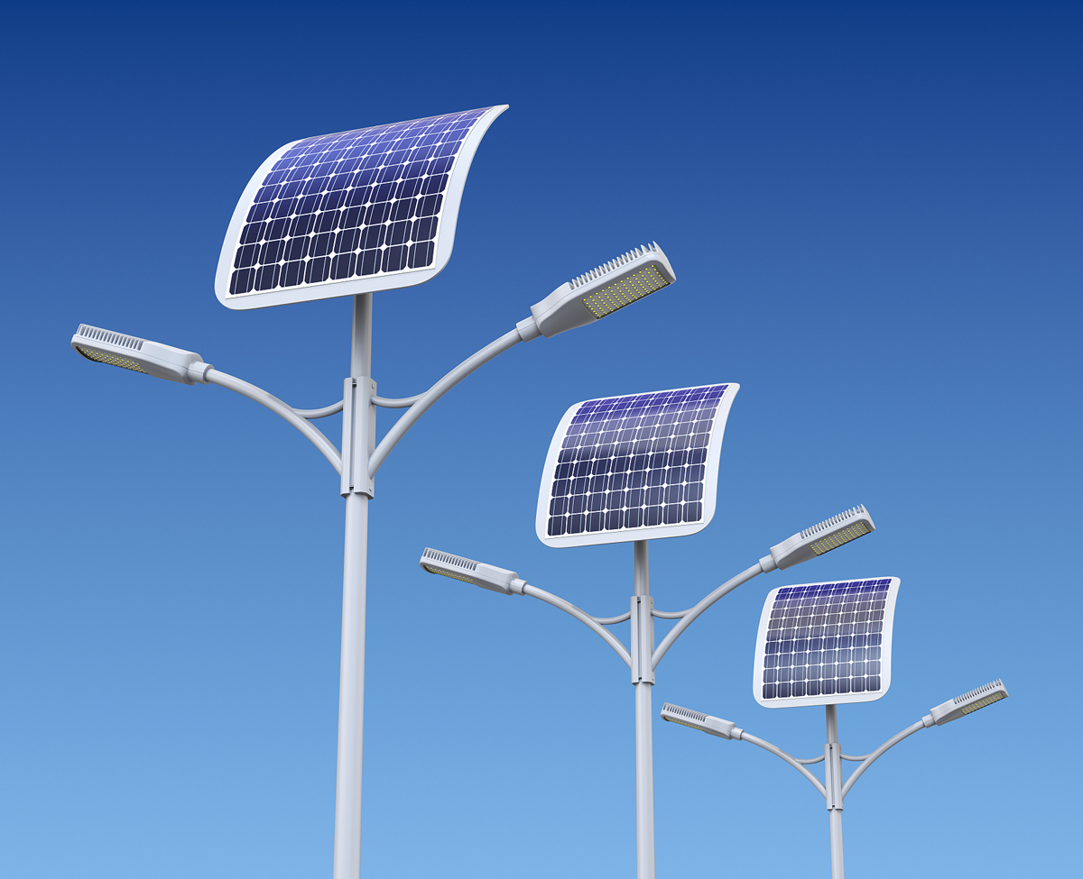
Solar-Powered Street Lights
Solar-powered street lights use solar panels to generate electricity during the day and illuminate streets at night.
These lights are cost-effective, energy-efficient, and environmentally friendly.
Solar-powered street lights are widely used in urban and rural areas to enhance safety and reduce energy consumption.
Notes:
Image source: https://www.pinankenergy.com/solar-street-lights/

Slide 6
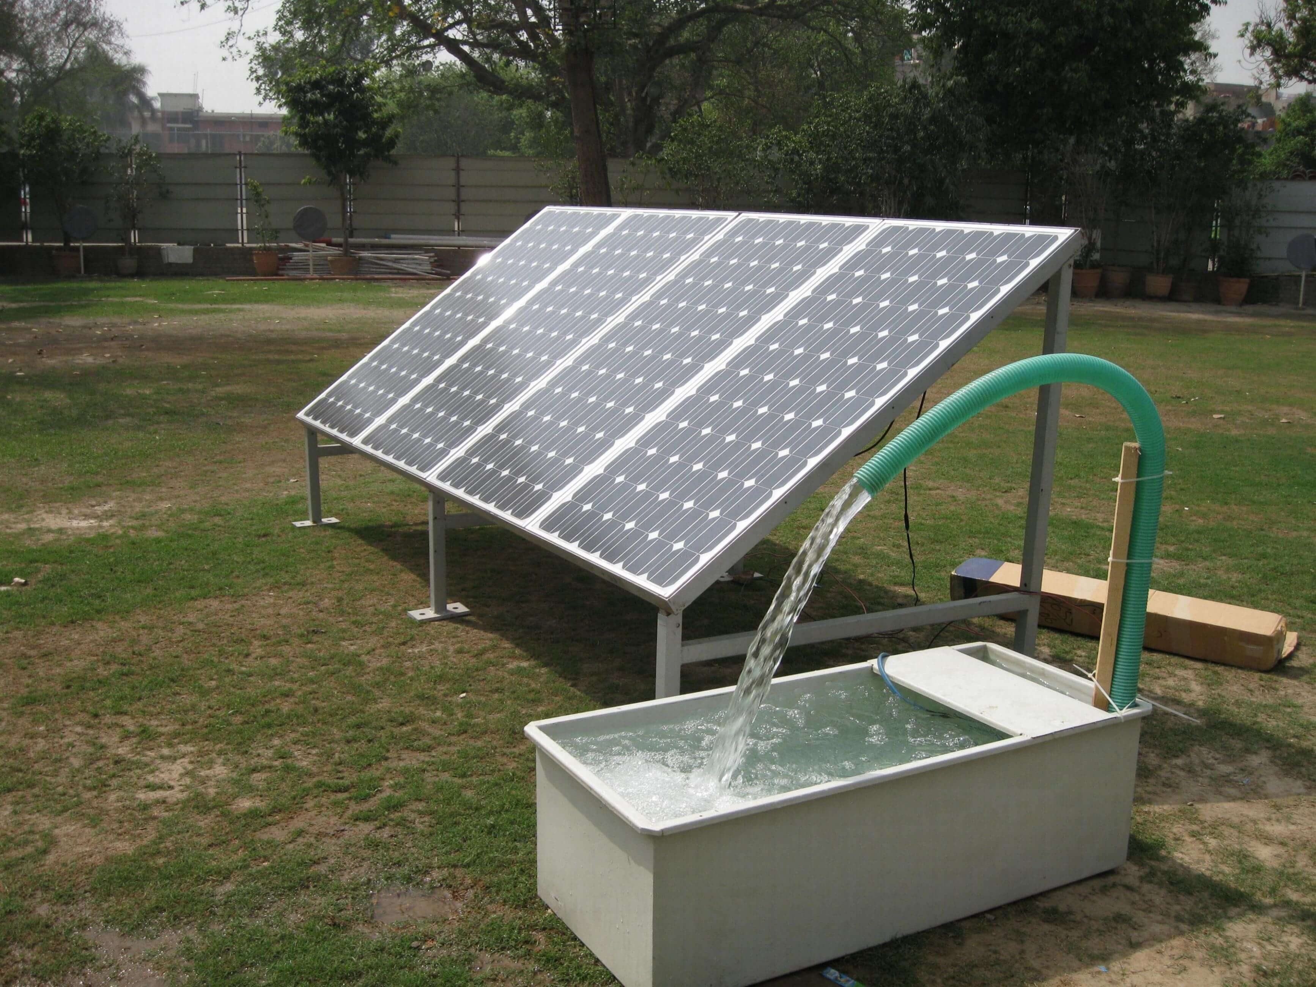
Solar-Powered Water Pumping Systems
Solar-powered water pumping systems use solar energy to pump water from wells, rivers, or reservoirs.
These systems provide a sustainable and reliable source of water for irrigation, livestock, and domestic purposes.
Solar-powered water pumping systems are particularly beneficial in remote areas with limited access to electricity.
Notes:
Image source: https://havenhillsynergy.com/services/solar-powered-water-pumping-systems/

Slide 7
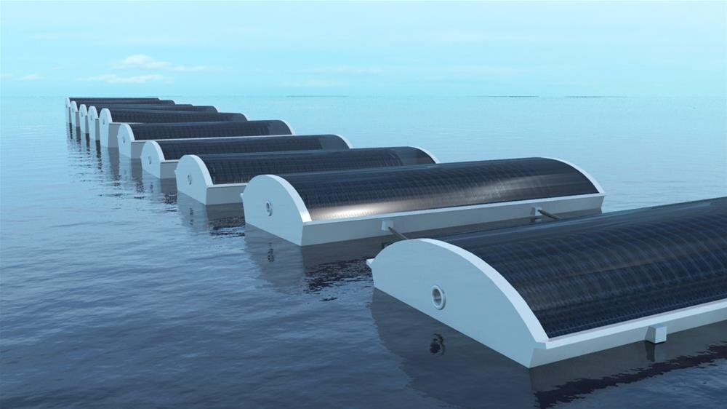
Solar-Powered Desalination
Solar-powered desalination systems use solar energy to convert seawater into freshwater.
These systems help address freshwater scarcity in coastal regions.
Solar-powered desalination has the potential to provide clean drinking water to millions of people worldwide.
Notes:
Image source: https://www.tehrantimes.com/news/444541/Iranian-company-acquires-solar-desalination-technology

Slide 8
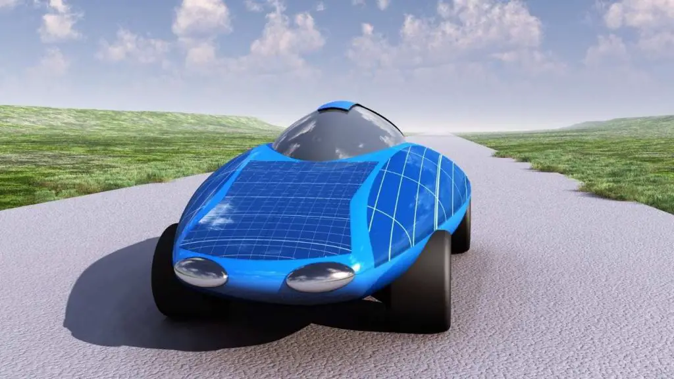
Solar-Powered Vehicles
Solar-powered vehicles use solar panels to generate electricity and power electric motors.
These vehicles reduce dependence on fossil fuels and contribute to reducing carbon emissions.
Solar-powered vehicles are a promising solution for sustainable transportation in the future.
Notes:
Image source: https://thephoenixsun.com/benefits-and-drawbacks-of-solar-energy-cars/

Slide 9
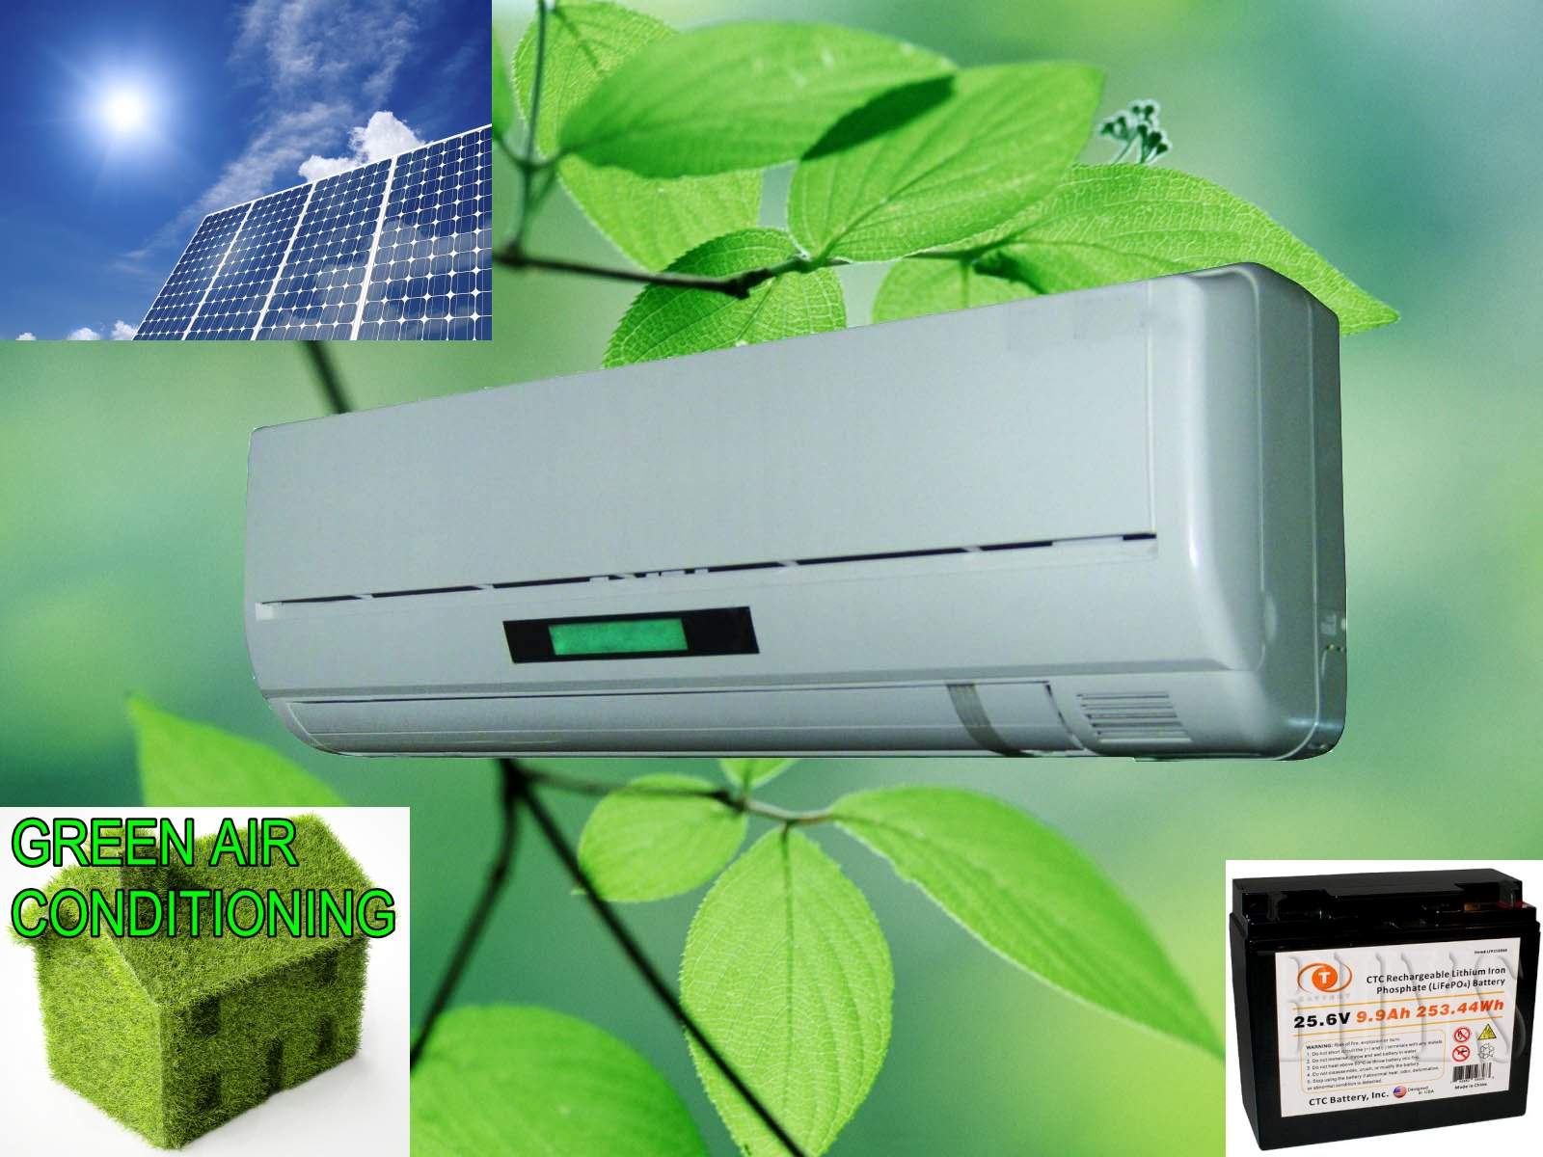
Solar-Powered Air Conditioning
Solar-powered air conditioning systems use solar energy to cool or heat indoor spaces.
These systems reduce energy consumption and lower electricity bills.
Solar-powered air conditioning is particularly effective in regions with abundant sunlight and high cooling demands.
Notes:
Image source: https://www.instructables.com/id/Solar-powered-air-conditioning-unit/

Slide 10
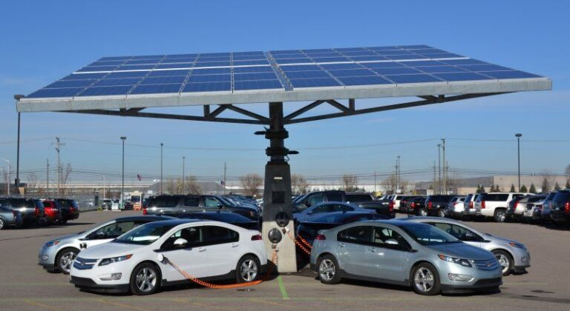
Solar-Powered Charging Stations
Solar-powered charging stations provide electricity for electric vehicles and mobile devices.
These stations are self-sufficient and can be installed in remote locations without access to the grid.
Solar-powered charging stations promote the adoption of electric vehicles and clean energy.
Notes:
Image source: https://evupdatemedia.com/envision-solar-deploys-the-first-state-owned-solar-powered-ev-charging-station-in-the-city-of-madison/

Slide 11
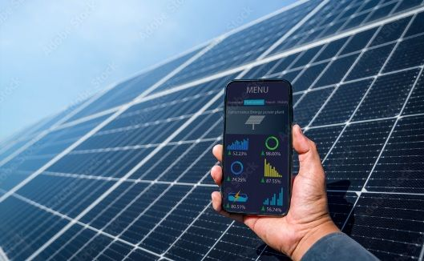
Solar-Powered Remote Monitoring Systems
Solar-powered remote monitoring systems use solar energy to power sensors and communication devices.
These systems monitor various parameters such as weather conditions, environmental data, and industrial processes.
Solar-powered remote monitoring systems are widely used in agriculture, meteorology, and industrial applications.
Notes:
Image source: https://regenpower.com/remote-monitoring-of-a-rooftop-solar-system-performance/

Slide 12
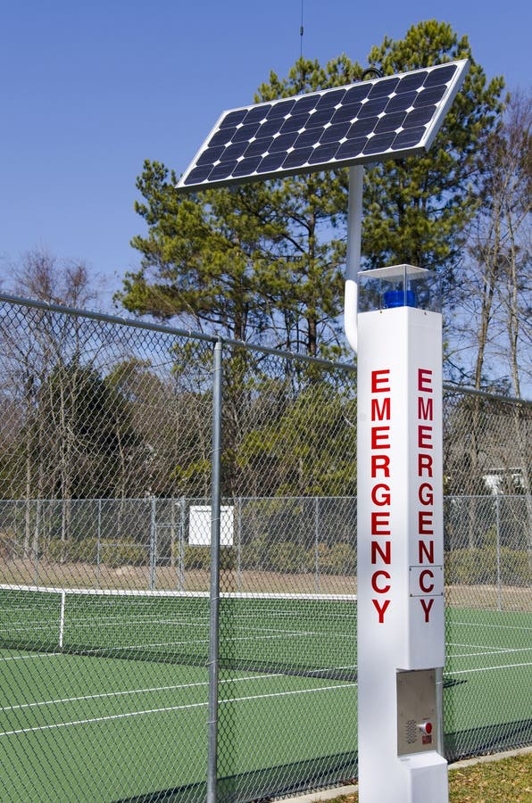
Solar-Powered Emergency Response Systems
Solar-powered emergency response systems provide electricity for communication, lighting, and medical equipment during emergencies.
These systems are crucial for disaster management and humanitarian aid efforts.
Solar-powered emergency response systems are portable, reliable, and can be deployed in remote areas.
Notes:
Image source: http://dreamstime.com/stock-images-solar-powered-emergency-call-station-image18340124

Slide 13
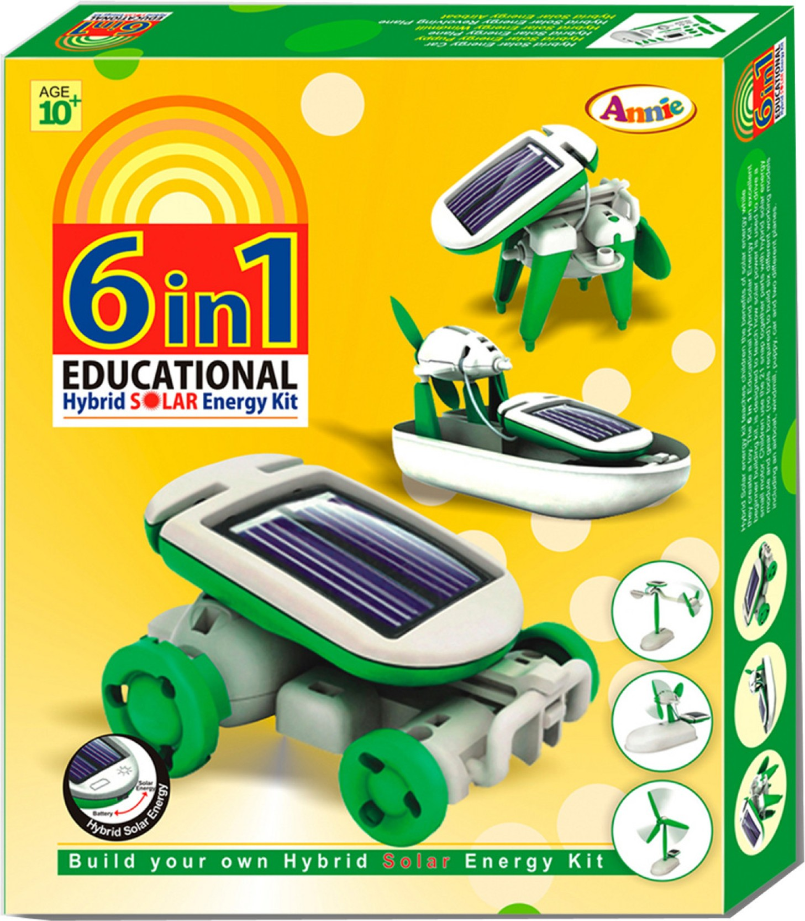
Solar-Powered Educational Tools
Solar-powered educational tools, such as solar-powered calculators and toys, teach children about renewable energy.
These tools demonstrate the practical applications of solar energy in a fun and interactive manner.
Solar-powered educational tools help raise awareness about sustainability and inspire future generations.
Notes:
Image source: https://www.flipkart.com/annie-toys-6-1-educational-hybrid-solar-energy-kit/p/itmdzdv9dsudy7hc

Slide 14
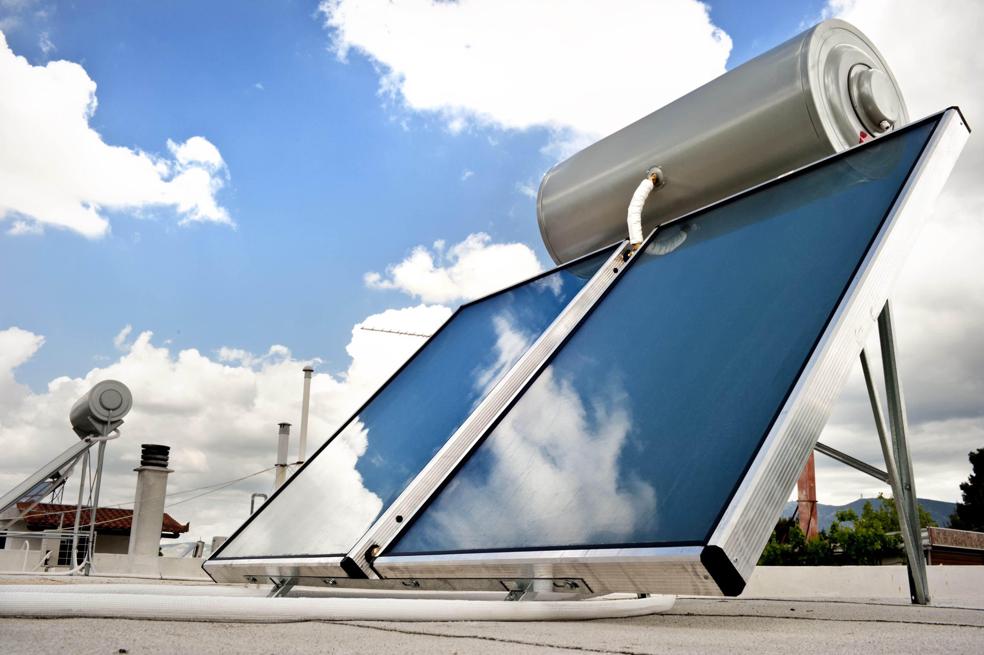
Solar-Powered Water Heaters
Solar-powered water heaters use solar energy to heat water for domestic or commercial use.
These systems reduce energy consumption and lower water heating costs.
Solar-powered water heaters are widely used in residential, commercial, and industrial buildings.
Notes:
Image source: https://energy.gov/energysaver/solar-water-heaters

Slide 15
Solar-Powered Remote Sensing
Solar-powered remote sensing systems use solar energy to power sensors and collect data about the earth's atmosphere, land, and oceans.
These systems are crucial for climate research, environmental monitoring, and weather forecasting.
Solar-powered remote sensing helps scientists understand and mitigate the impacts of climate change.
Notes:
Image source: http://www.weathershop.com/cellular_weather_station.htm

Slide 16
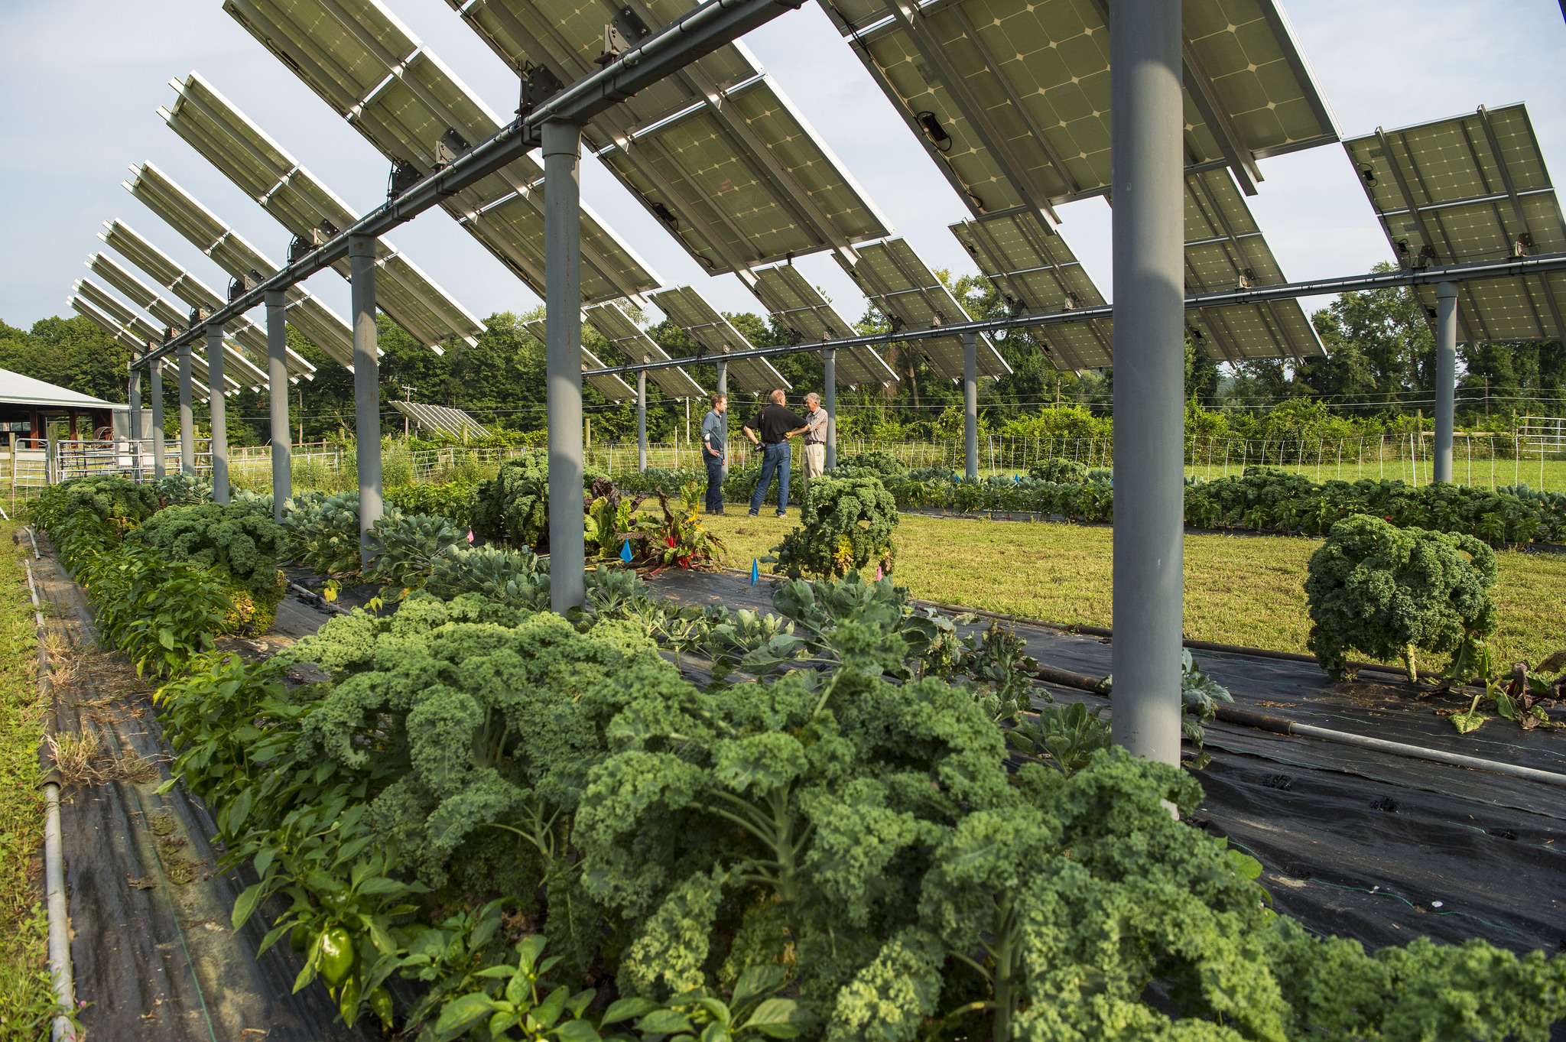
Solar-Powered Agriculture
Solar-powered agriculture systems use solar energy for irrigation, greenhouse heating, and crop drying.
These systems improve agricultural productivity and reduce reliance on fossil fuels.
Solar-powered agriculture promotes sustainable farming practices and enhances food security.
Notes:
Image source: https://betterenergy.org/blog/solar-plus-how-solar-integrated-agriculture-could-reduce-barriers-to-large-scale-solar-deployment/

Slide 17
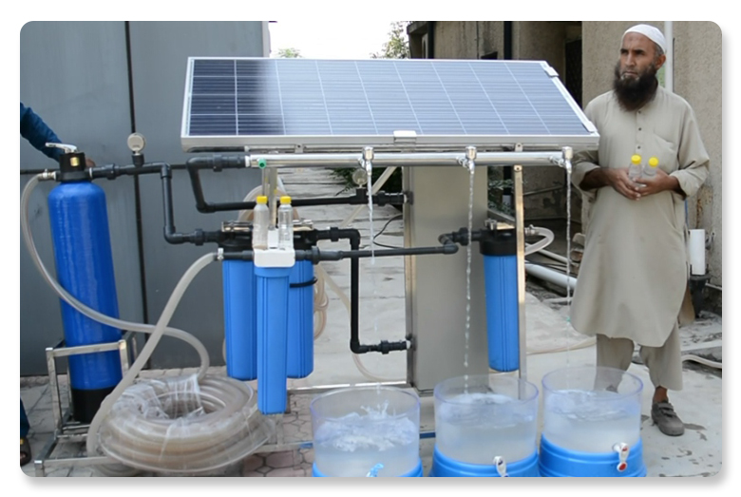
Solar-Powered Water Purification
Solar-powered water purification systems use solar energy to disinfect and purify water for drinking or other purposes.
These systems provide a sustainable and cost-effective solution for clean water access.
Solar-powered water purification is particularly beneficial in developing countries and areas affected by natural disasters.
Notes:
Image source: https://nrsp.org.pk/hand-operated-and-solar-powered-portable-water-filtration-units/

Slide 18
Solar-Powered Refrigeration
Solar-powered refrigeration systems use solar energy to power refrigerators and freezers.
These systems are crucial for storing vaccines, medicines, and perishable food items in off-grid areas.
Solar-powered refrigeration ensures the preservation of essential supplies and improves healthcare services.
Notes:
Image source: https://tongbosolar.en.made-in-china.com/product/RsVEcjAOHfhn/China-45L-93L-DC-12V-Solar-Energy-Fridge-Triple-Power-Integrated.html

Slide 19
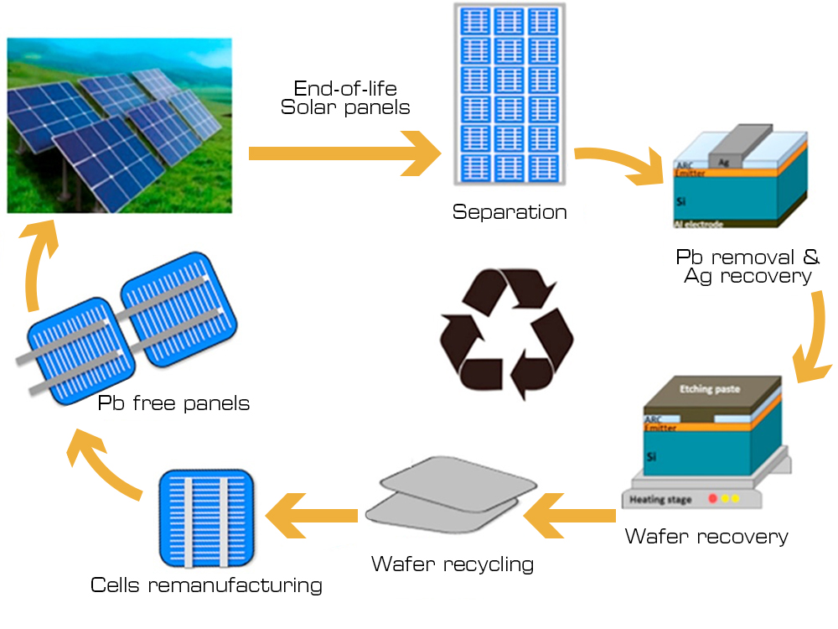
Solar-Powered Waste Management
Solar-powered waste management systems use solar energy to power waste treatment plants and recycling facilities.
These systems reduce reliance on conventional energy sources and decrease the environmental impact of waste management.
Solar-powered waste management contributes to a circular economy and sustainable resource management.
Notes:
Image source: https://ae-solar.com/solar-module-recycling/

Slide 20
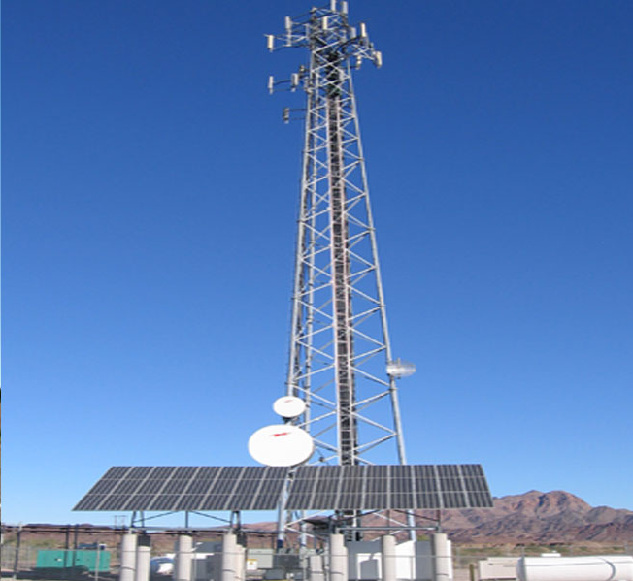
Solar-Powered Communication Systems
Solar-powered communication systems use solar energy to power telecommunication towers, satellite stations, and remote communication devices.
These systems ensure reliable communication in off-grid and remote areas.
Solar-powered communication systems are essential for disaster management, remote sensing, and connecting underserved communities.
Notes:
Image source: https://www.indiamart.com/proddetail/solar-powered-telecom-towers-15683420855.html

Slide 21
Conclusion
Solar photovoltaic conversion has a wide range of applications, from power generation to water pumping, transportation, and education.
Solar energy is a clean, renewable, and sustainable resource that can help address various global challenges.
Continued research, innovation, and deployment of solar photovoltaic technologies are crucial for a sustainable future.
Notes:
Image source: https://www.researchgate.net/figure/Typical-solar-PV-applications_fig6_321461989

